Slide 1



Media partner
YOURSTORY
Innovation partner
Team: AT-On The Go…. Leader: Akshat Tripathi

Slide 2
Problem Statement:
PROFESSIONAL TRACK : AI for Retail, Commerce & Market Intelligence
Build an AI-powered solution that enhances decision-making, efficiency, or user experience across retail, commerce, and marketplace ecosystems.

Slide 3
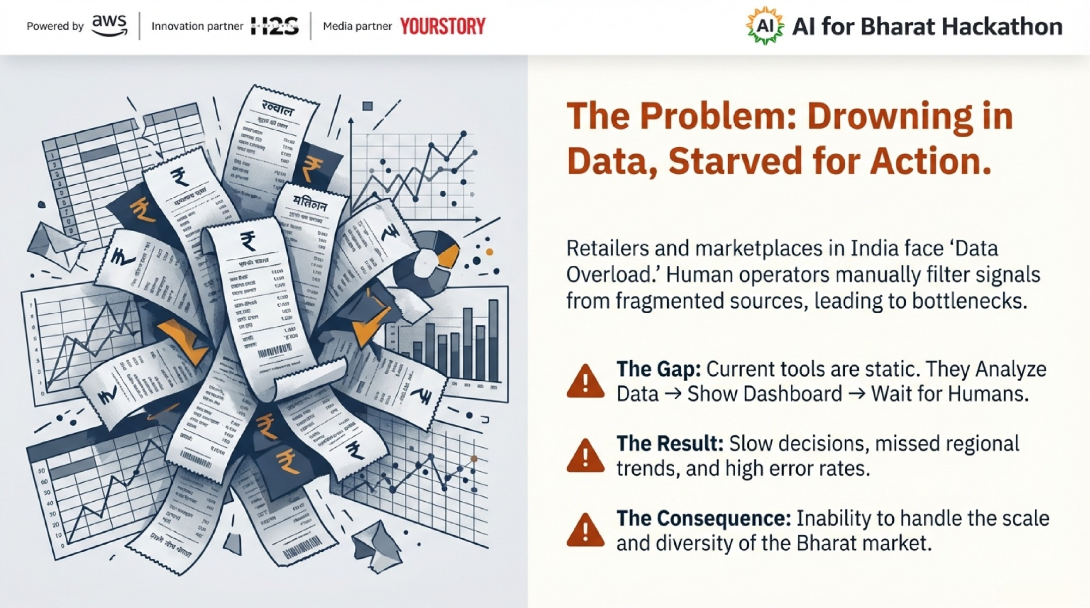

Slide 4
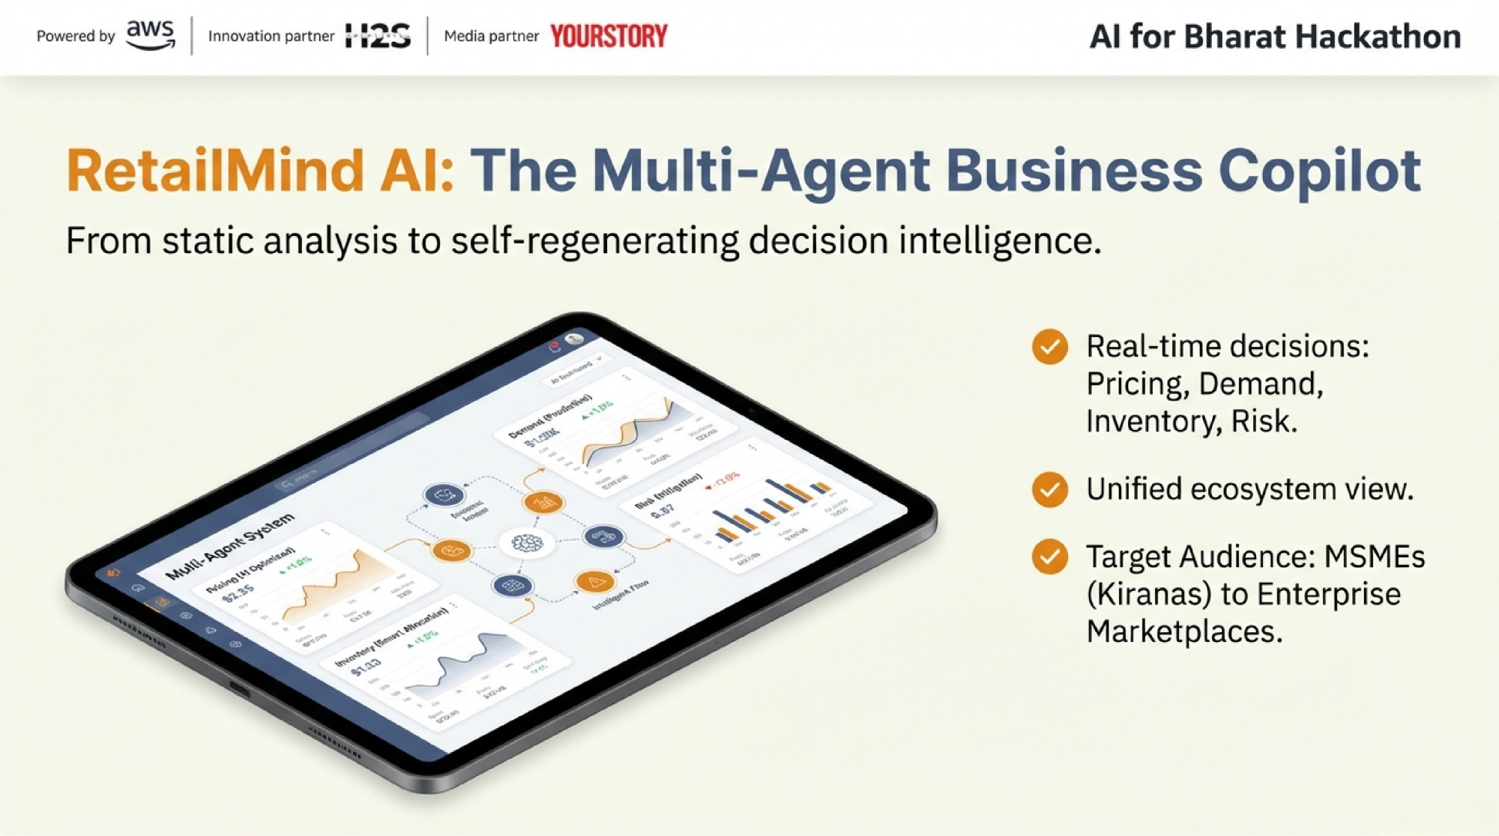

Slide 5
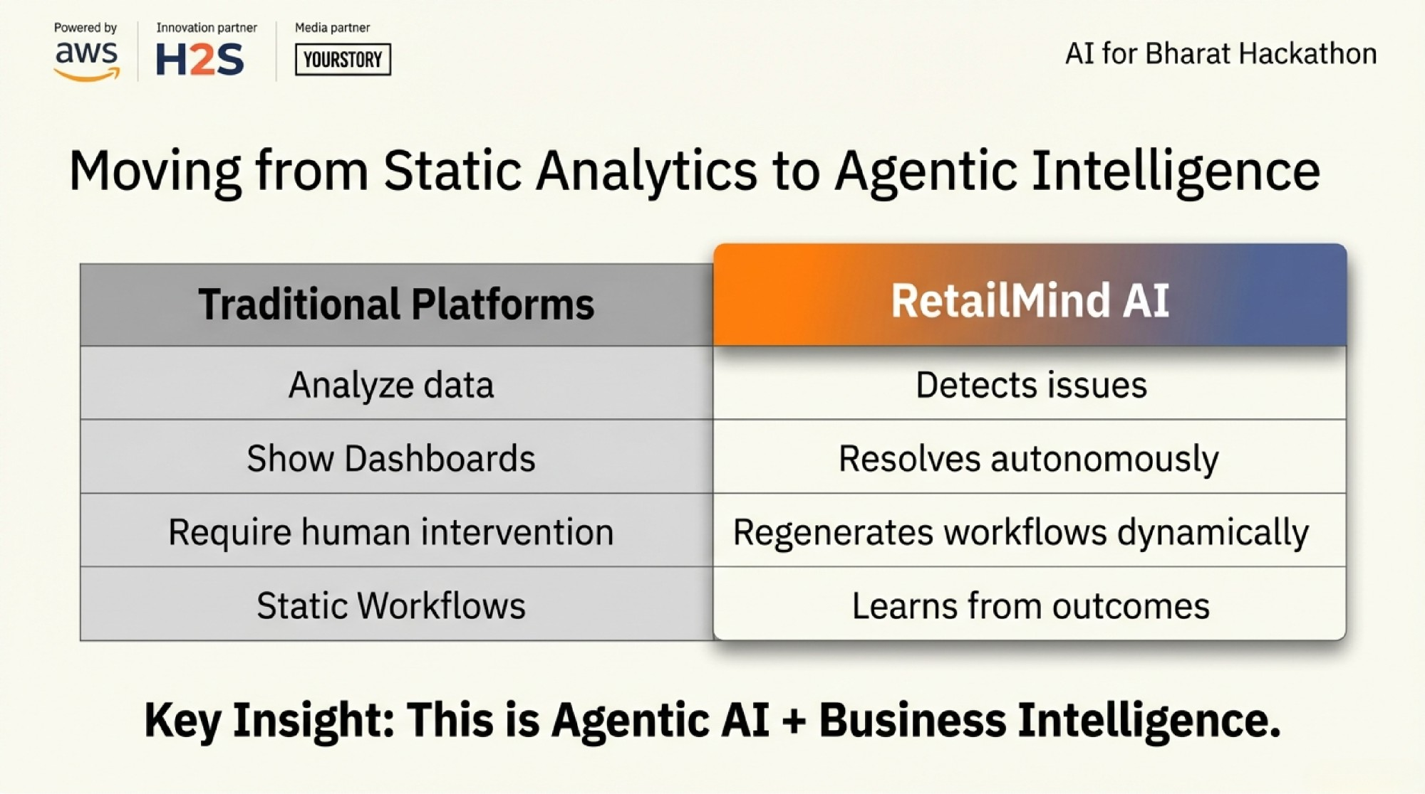

Slide 6
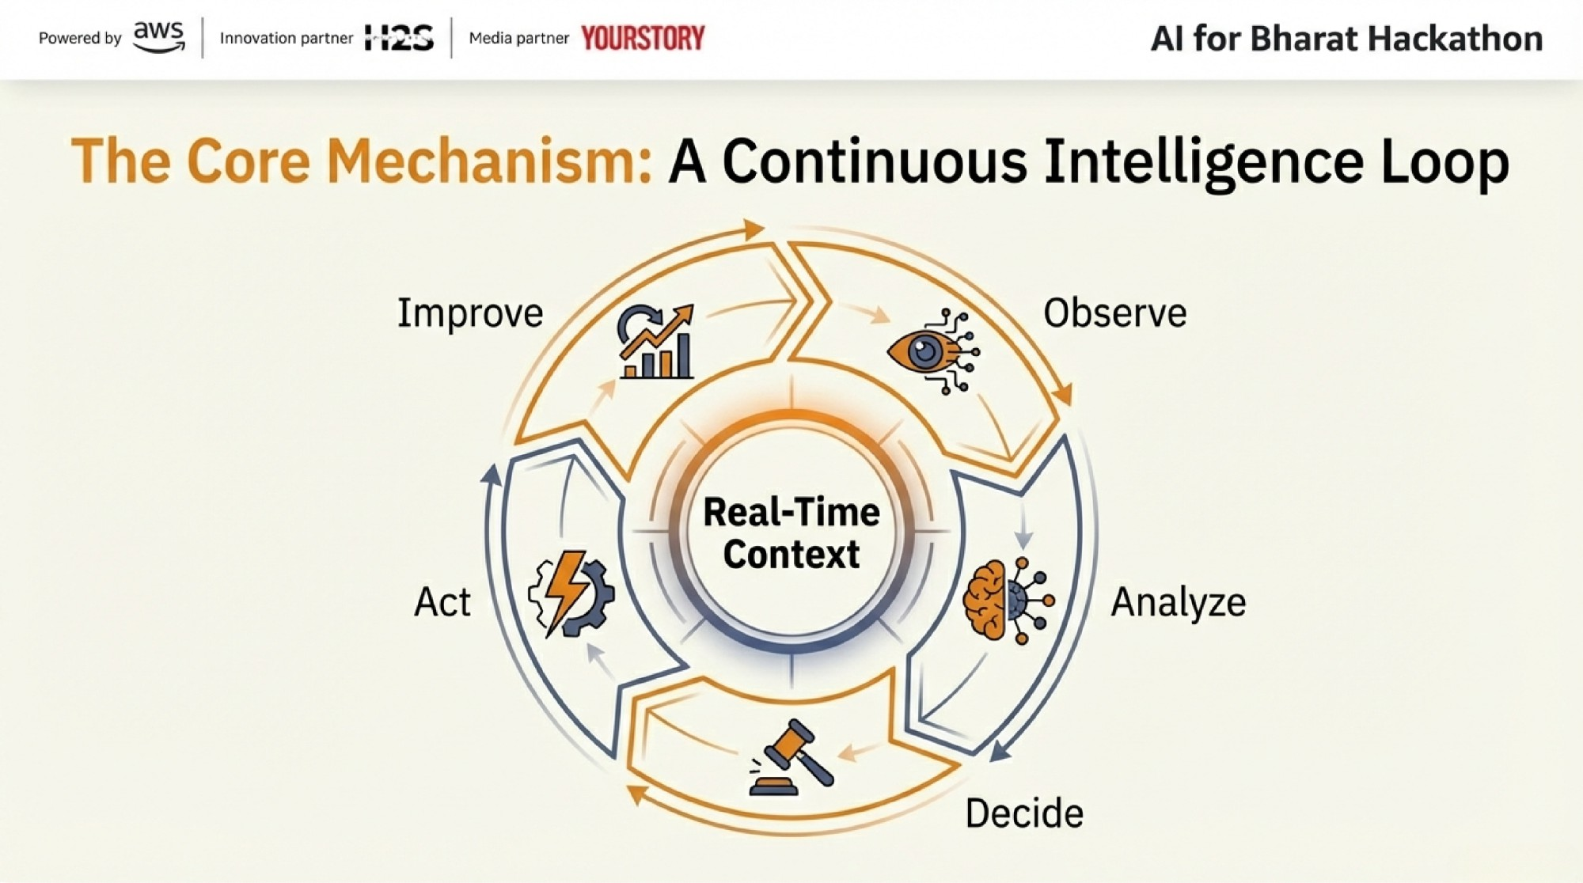

Slide 7
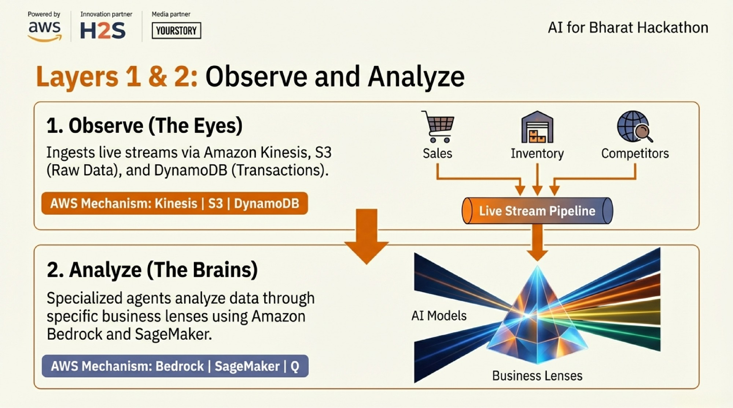

Slide 8
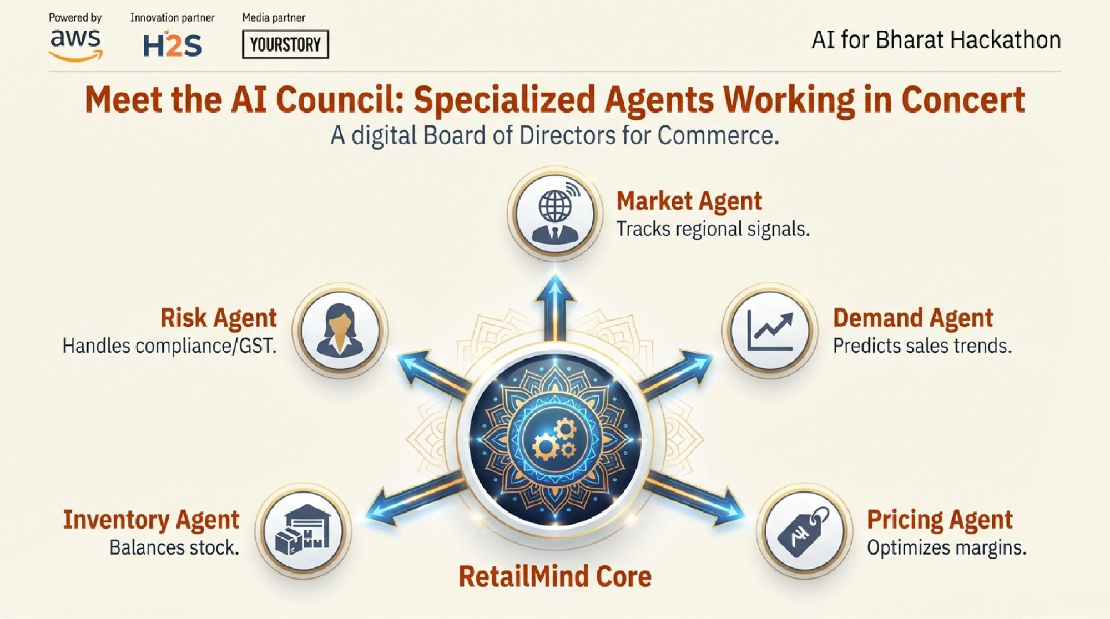

Slide 9
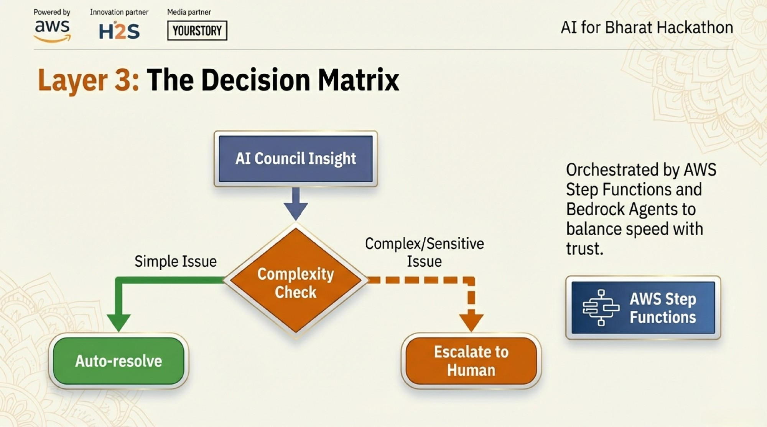

Slide 10
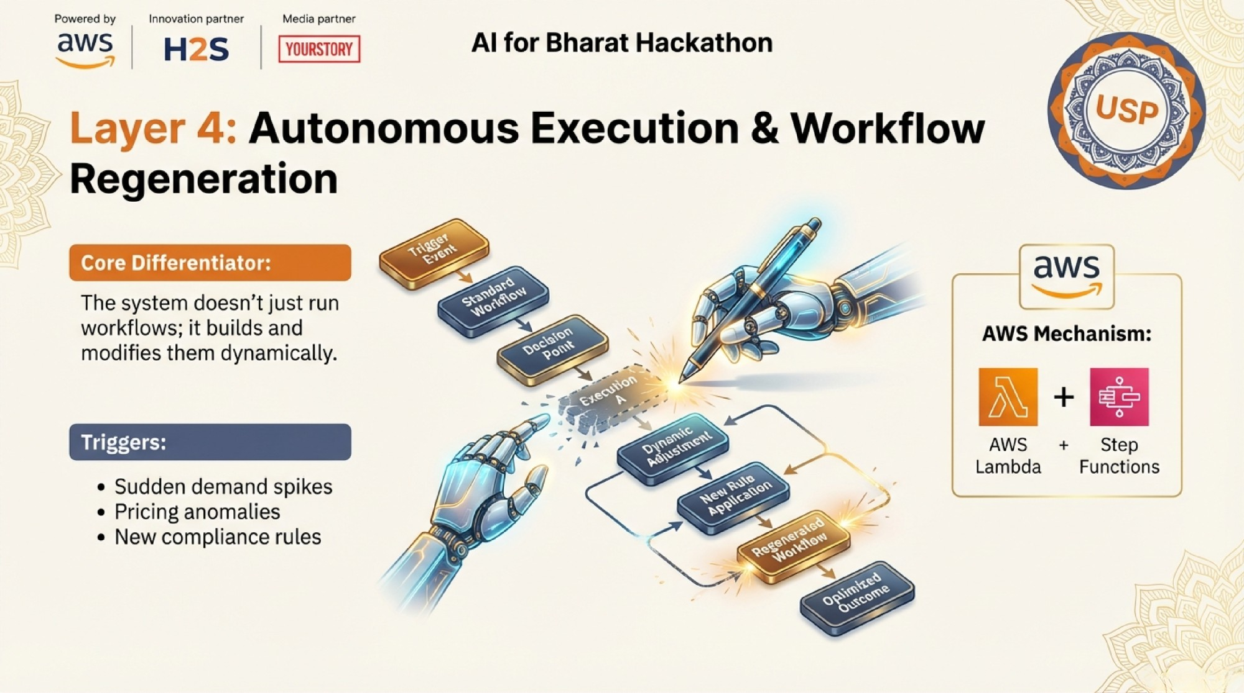

Slide 11
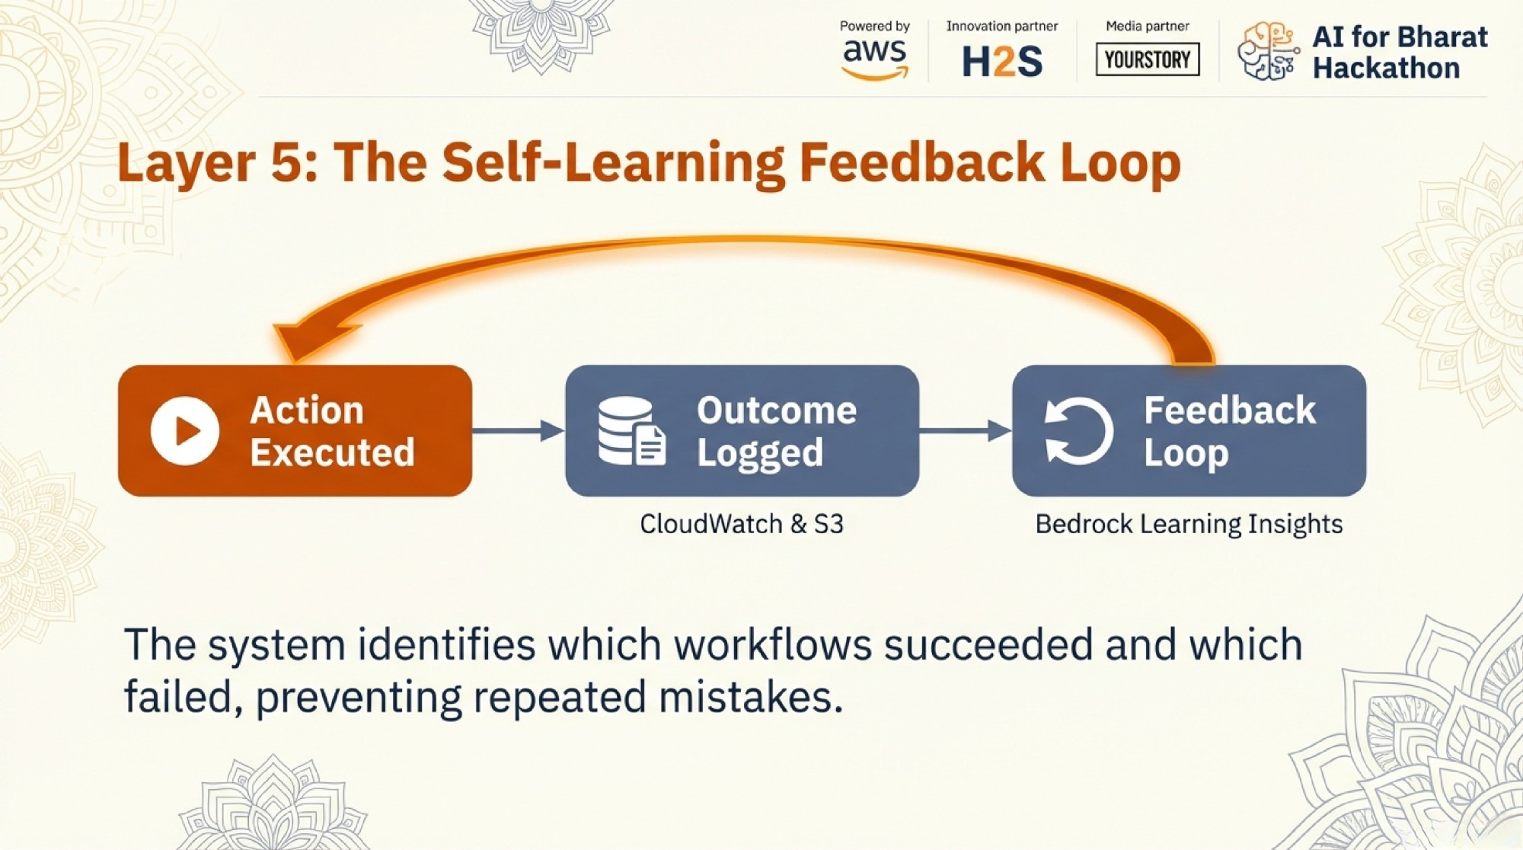

Slide 12
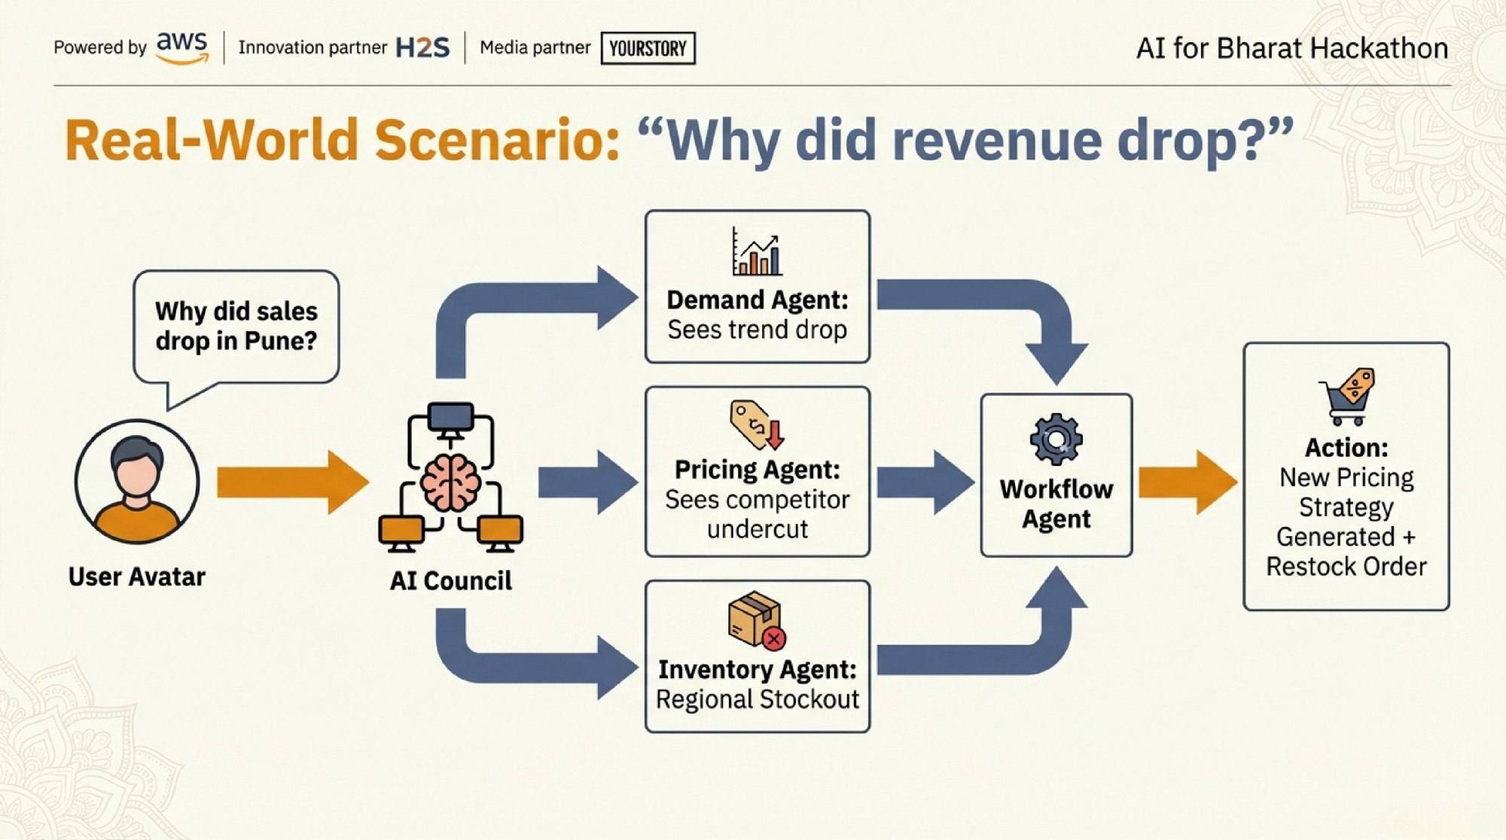

Slide 13
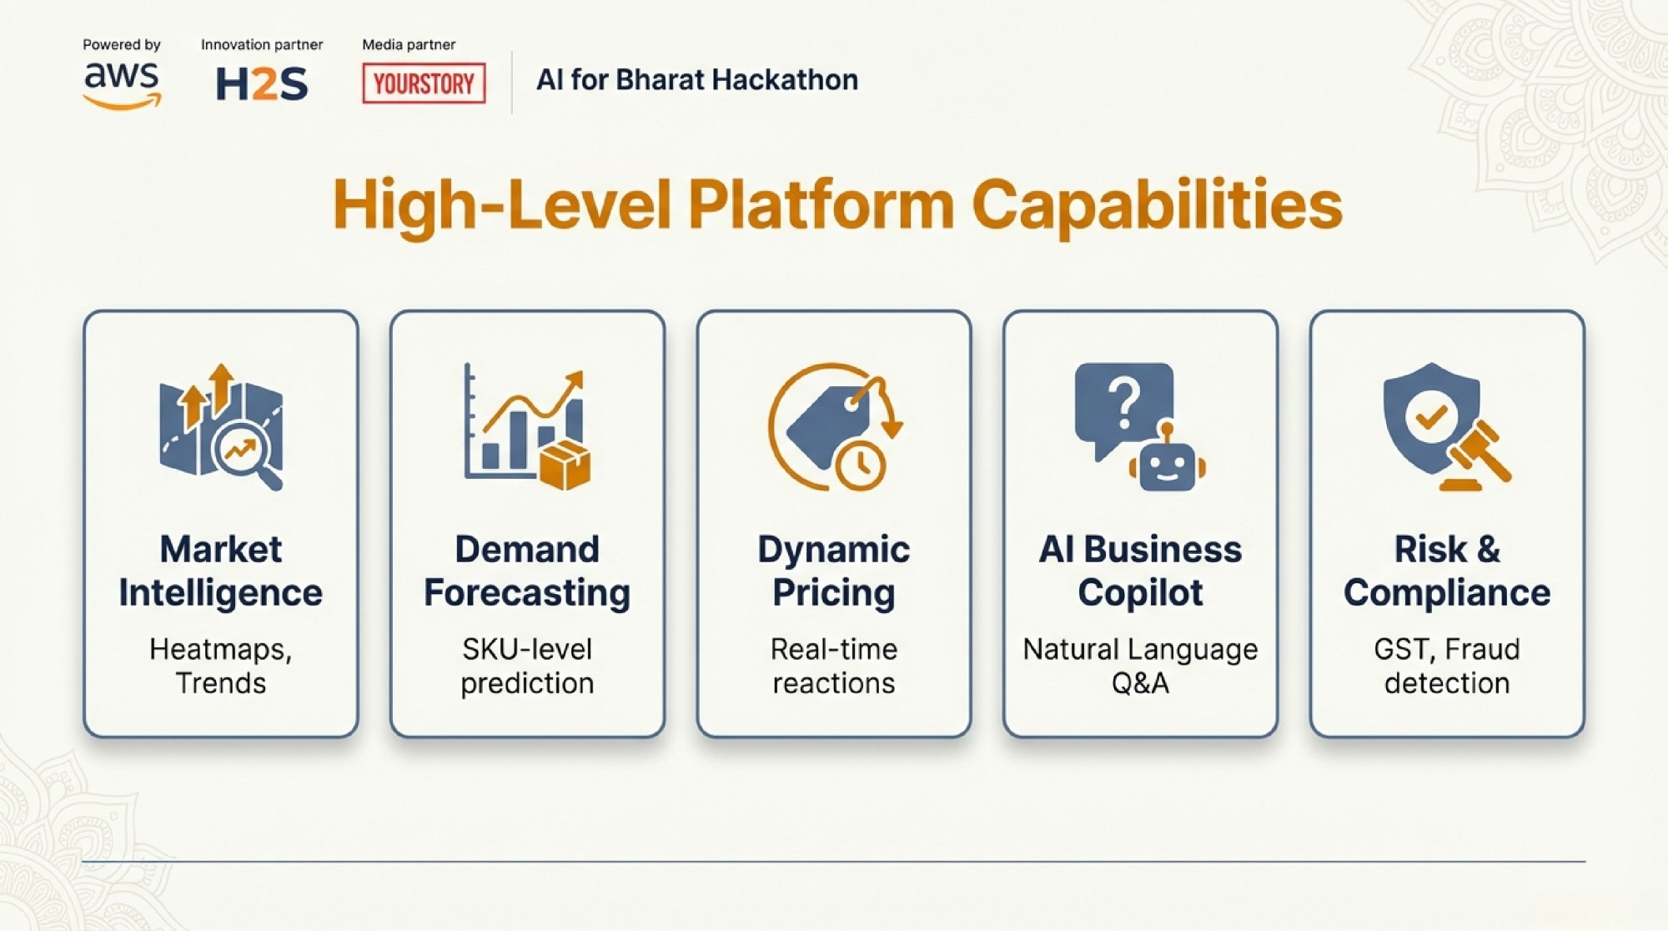

Slide 14
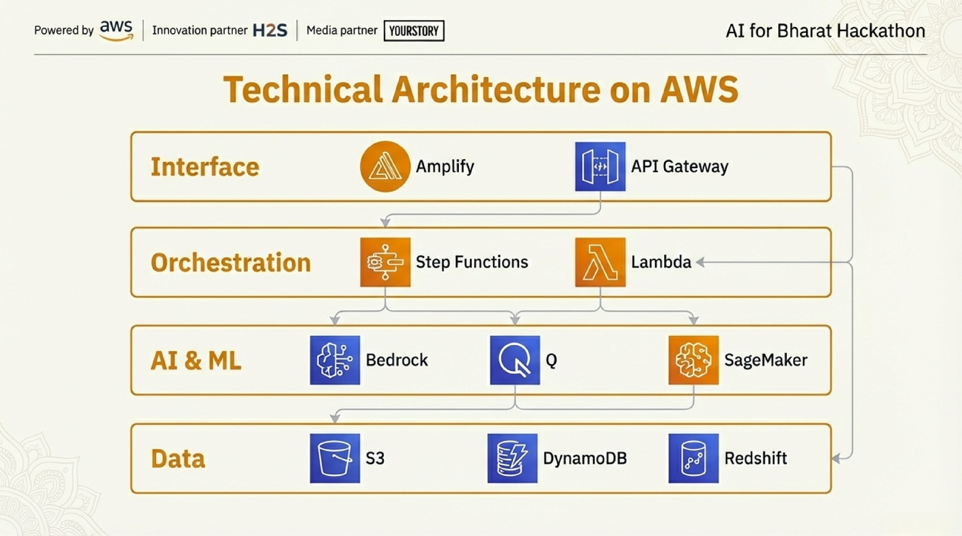

Slide 15
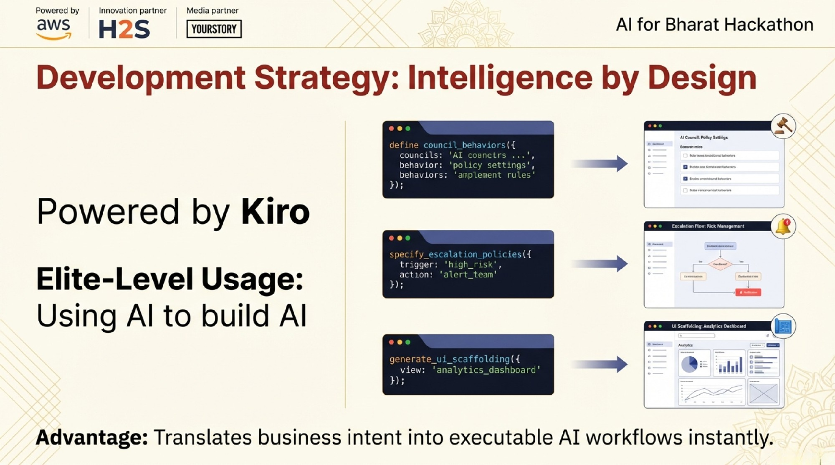

Slide 16
